Slide 1
Page Types

Slide 2


Learn
Search
Monitor

Slide 3
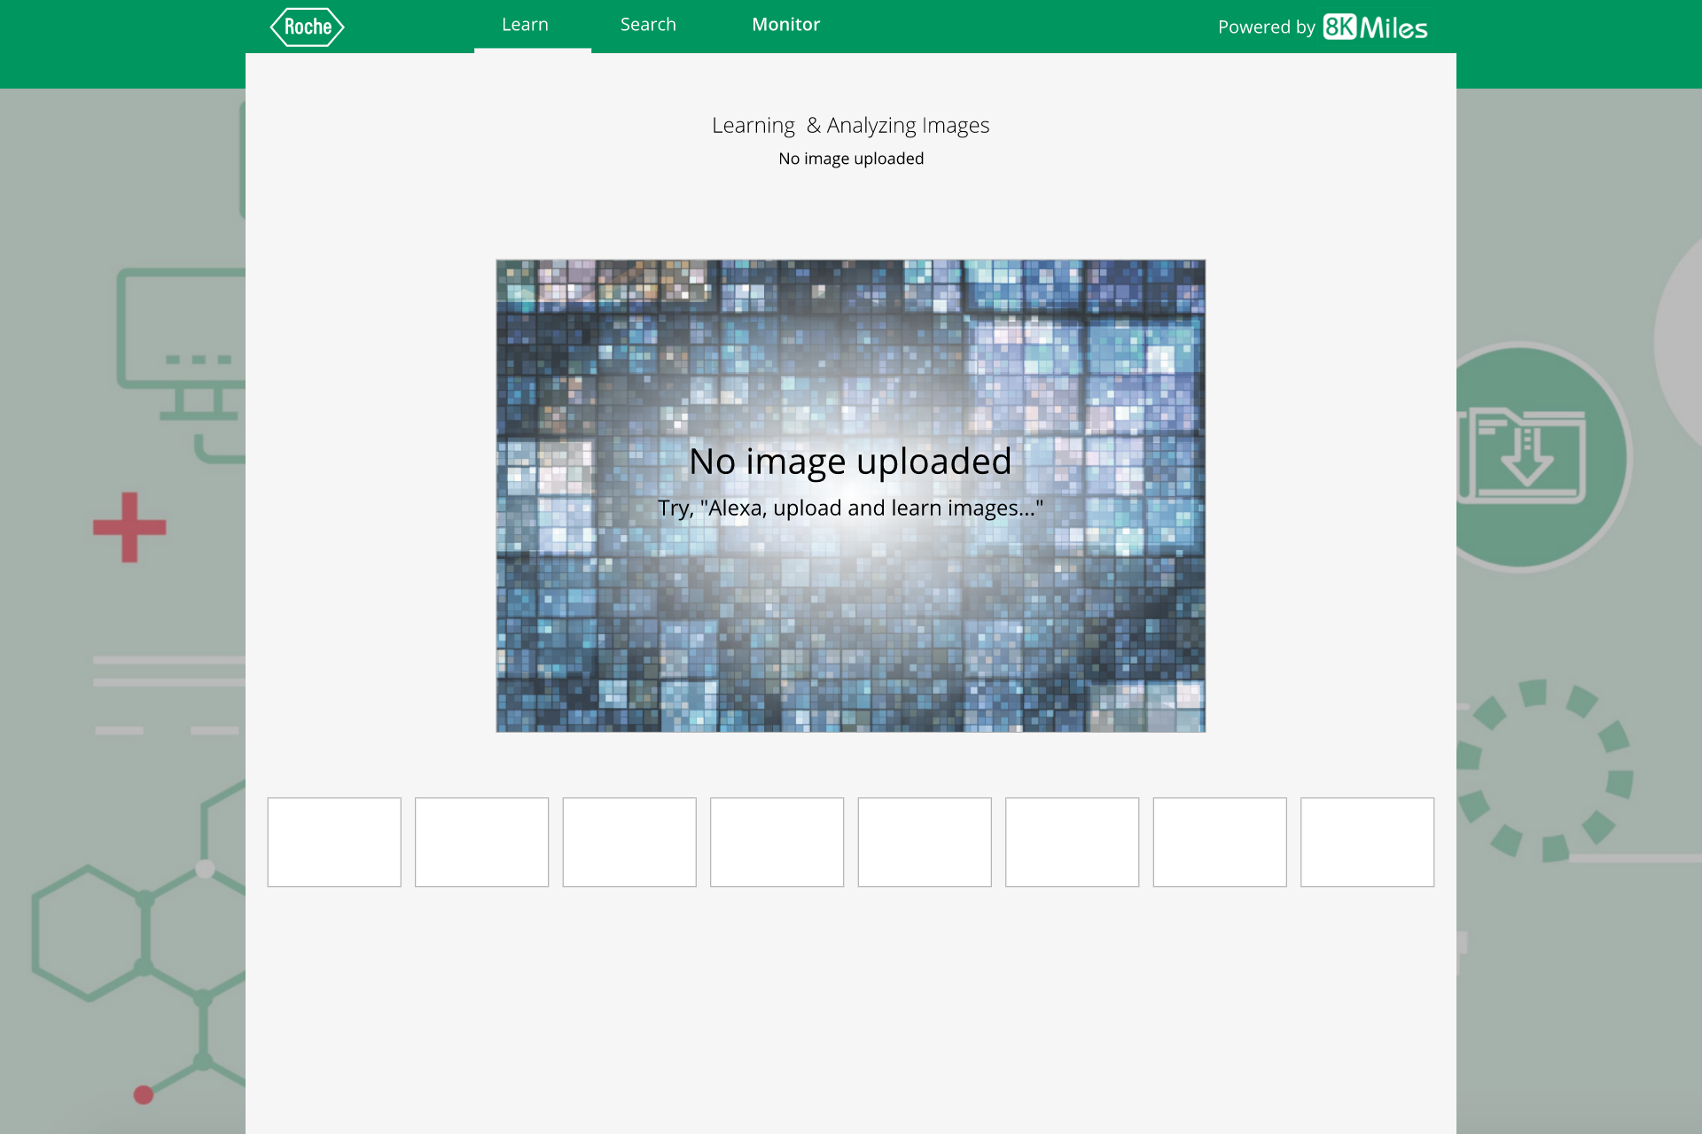


Slide 4
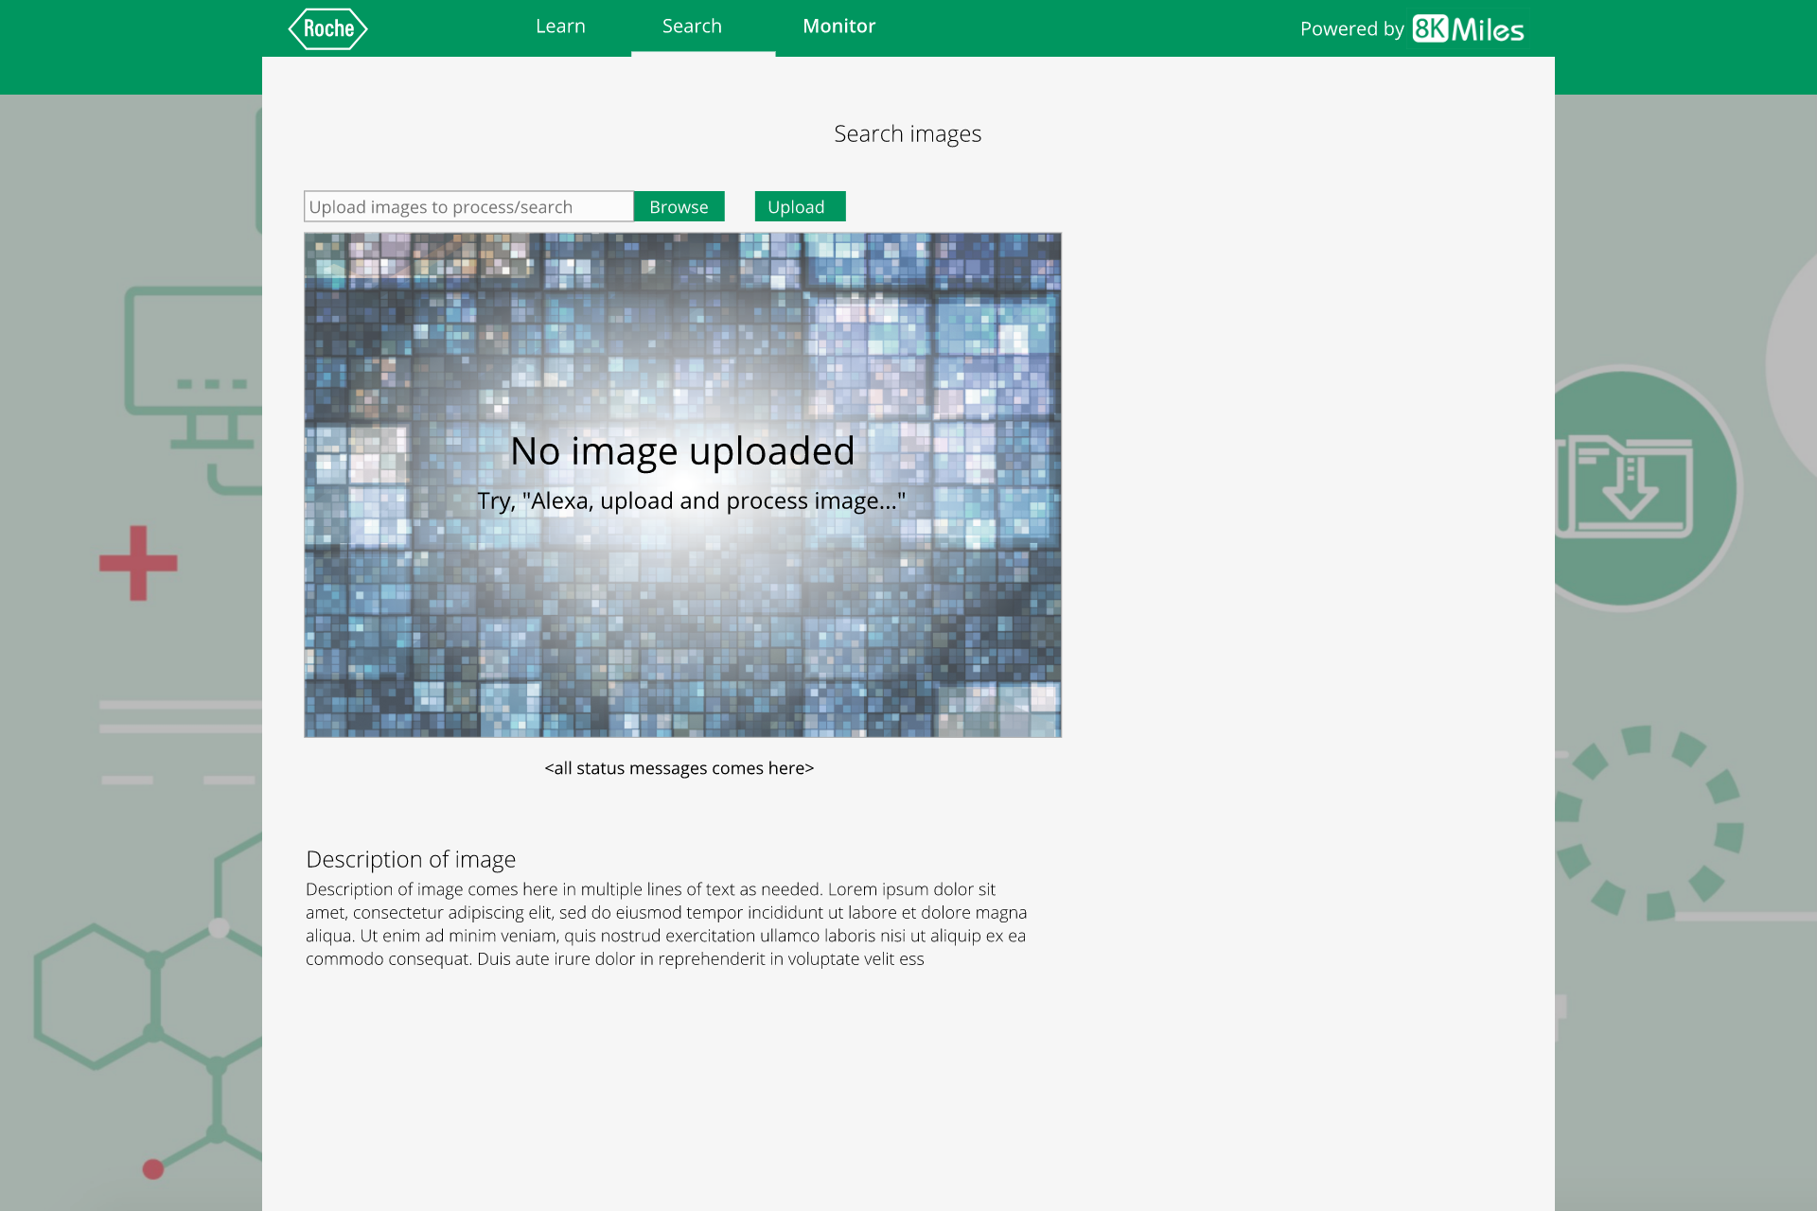

Send a photo via phone and say “Alexa process this image...”

Slide 5
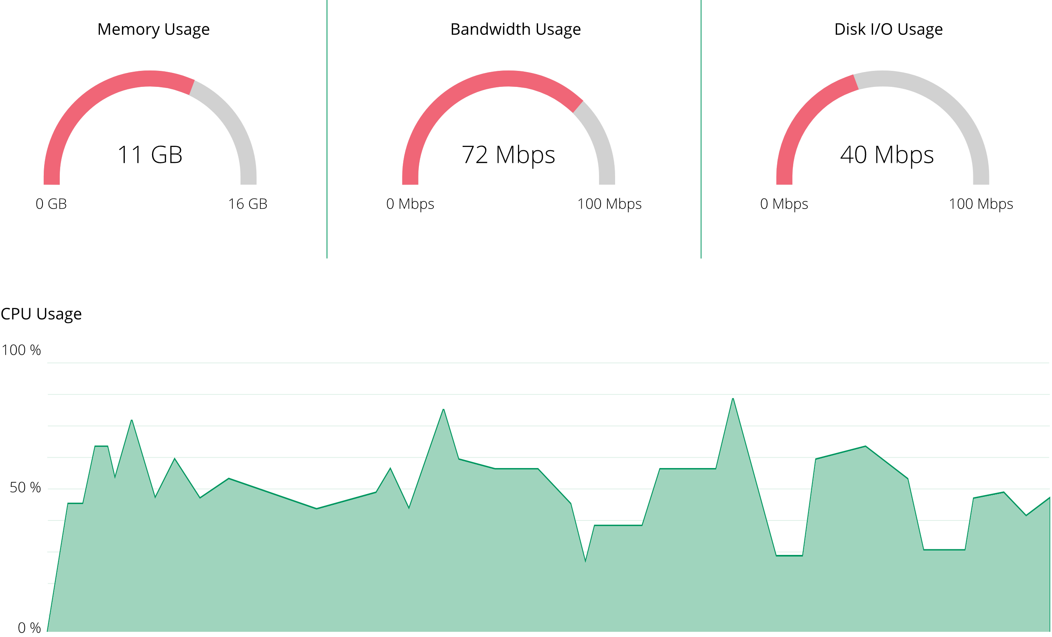
Usage
CPU Usage
44 %
0 %
100%
Logs
> AWS cloud trail logs or
> instance logs like API calls to AWS etc will come here
> this will scroll automatically as and how logs get shown here...
>
>

Slide 6
Screen flows

Slide 7
user says:
“Alexa, Learn images”

Slide 8
image upload in progress

Slide 9
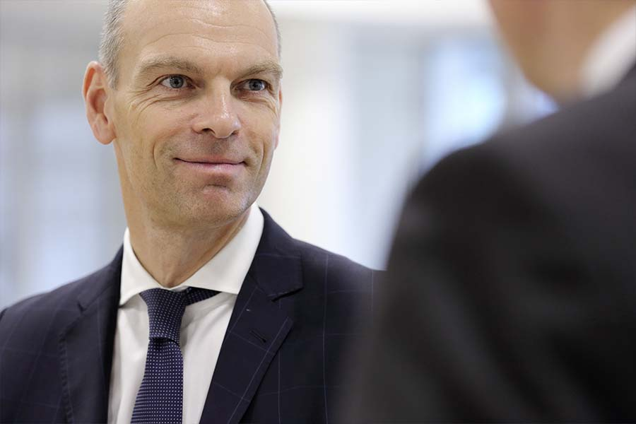
image upload in progress

Slide 10
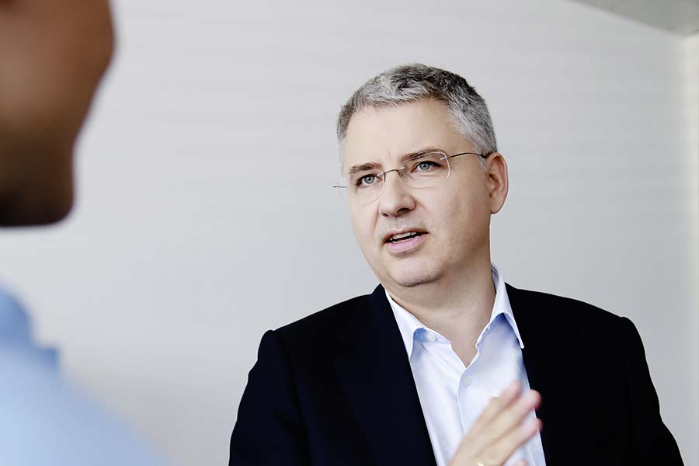
image upload in progress

Slide 11
image upload in progress
user says:
Yes, show me search tab
Pop up: new image uploaded. Try, “Alexa, switch to search tab” or “Alexa, show me the image”

Slide 12
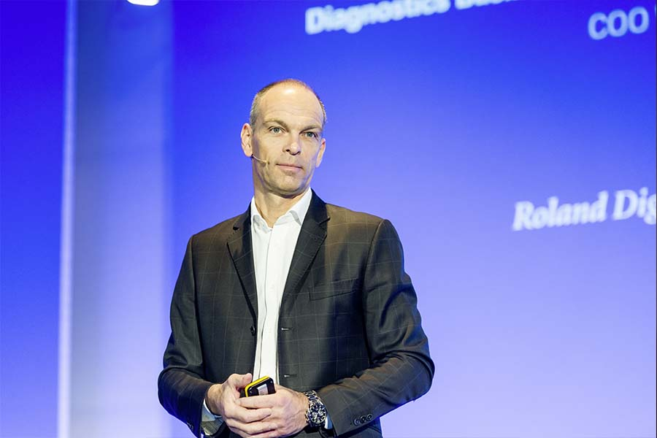
Send a photo via phone and say “Alexa process this image...”
status shows here.. e.g. image processing in progress
user says:
Alexa, do you know who this is?

Slide 13

Send a photo via phone and say “Alexa process this image...”
status shows here.. e.g. image processing completed
This is ....

